Slide 1
Revue de presse ...

Slide 2
Let’s play together Sport et cohésion sociale
Eleonora TARANDOVA
Forbes – Bulgarie
Marjorie NORNOO
Mondinsieme Intercultural Centre - Italie

Slide 4
And so what if Ronaldo is a “tapette” ?
Et qu’est ce que ça peut bien faire
si Ronaldo est un « faggot » ?
Nora SARGA Magyar Liget – Hungary
Jean-Paul VITRY Action Cinema Media Jeune - Belgium

Slide 5
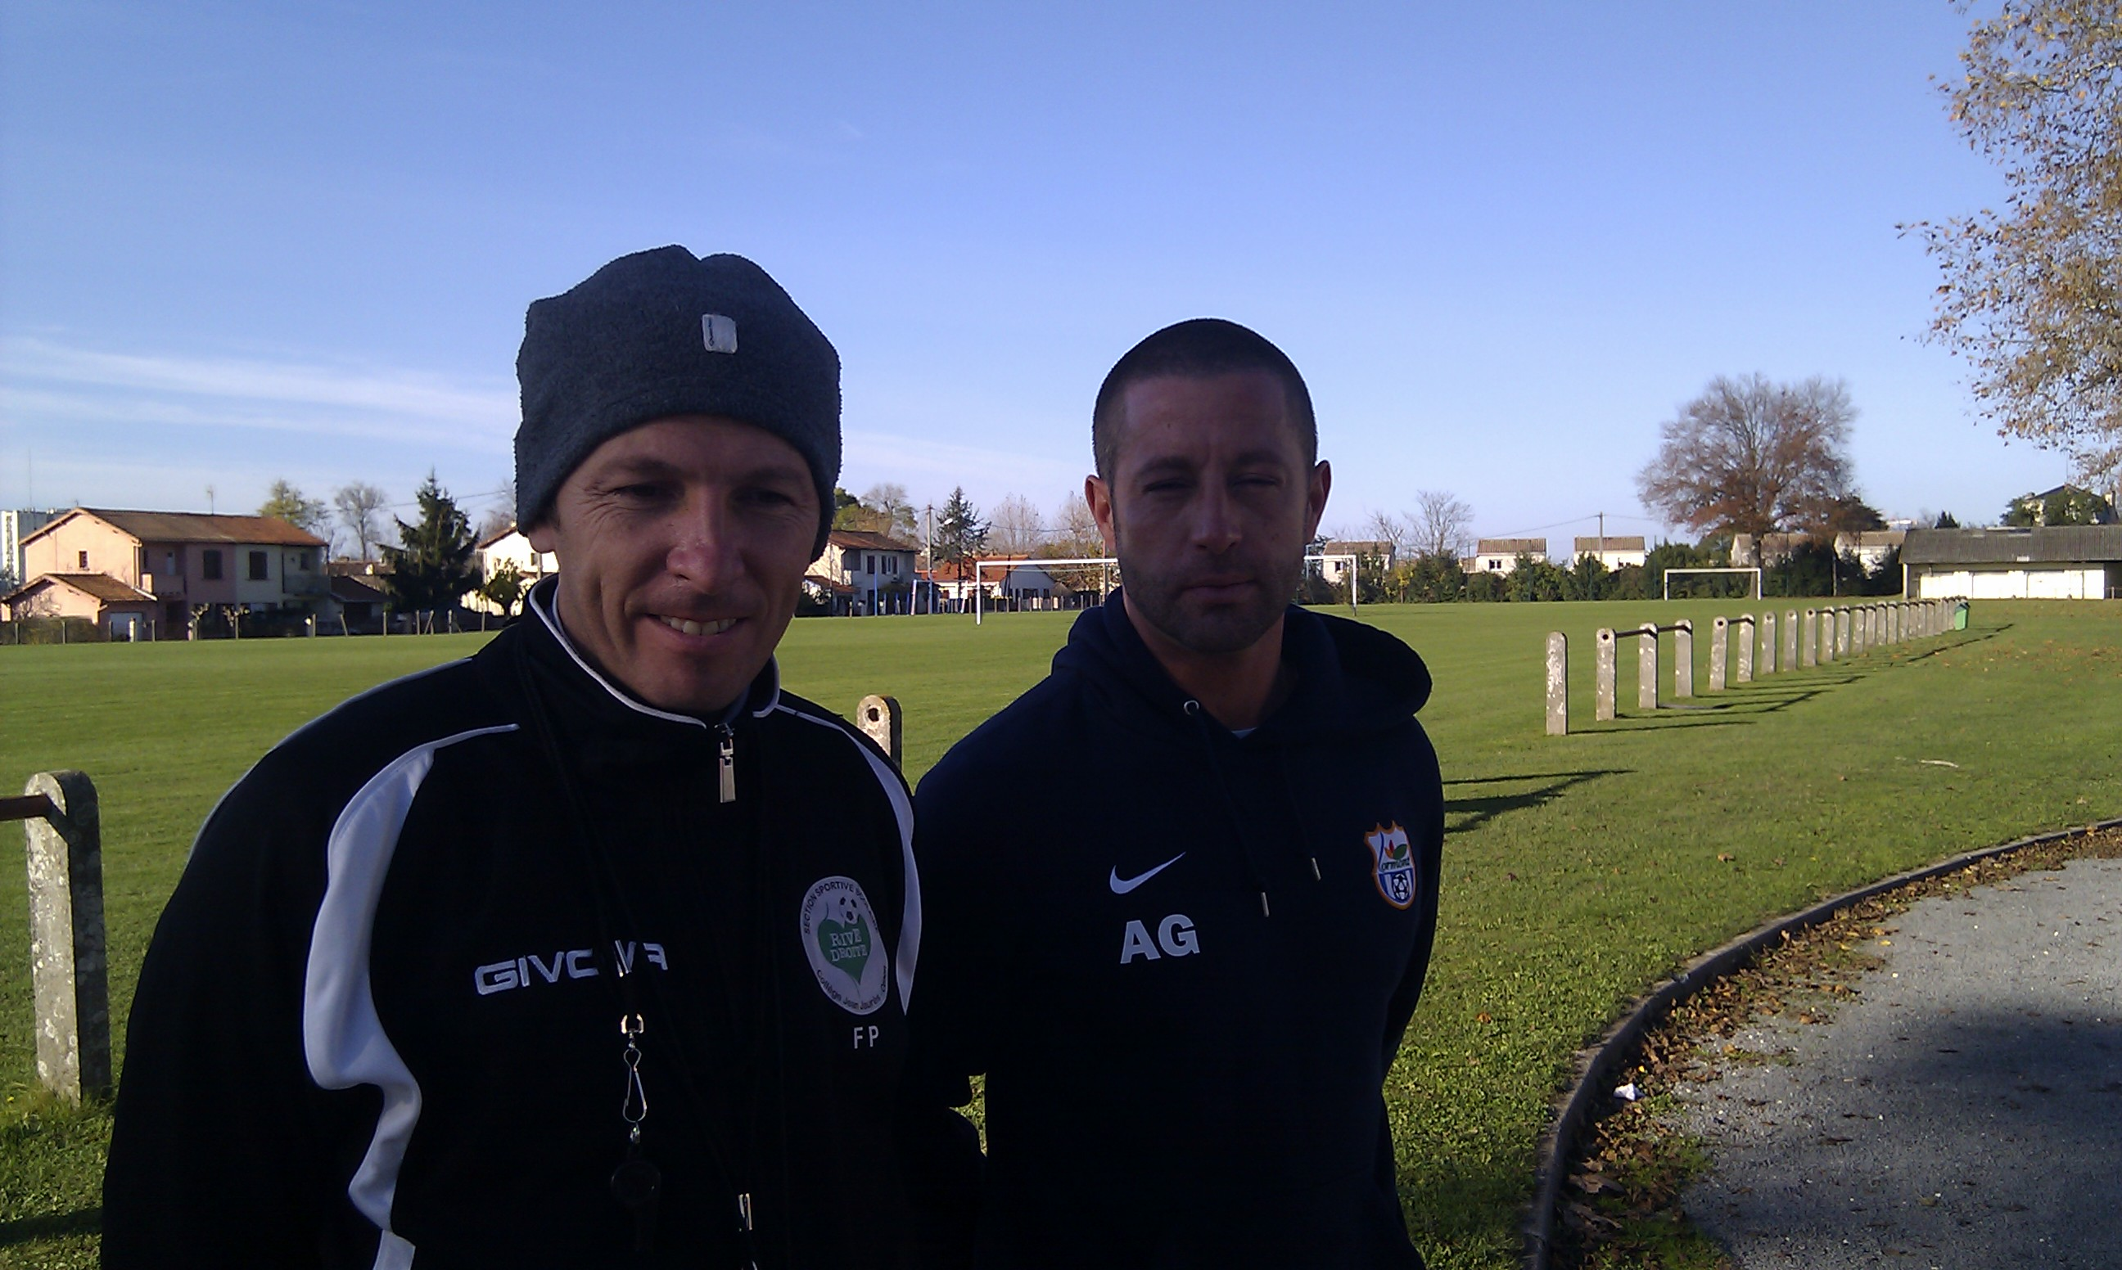
Fabien Pujo & Alexandre Gasparotto
Coach of amateurs of Lormont & Physical training coach

Slide 6
Des champions comme les autres
Champions just like other champions
Delyan KYUCHUKOV SEGA Newspaper - Bulgaria Ludovic CLERIMA Respect Magazine - France

Slide 7
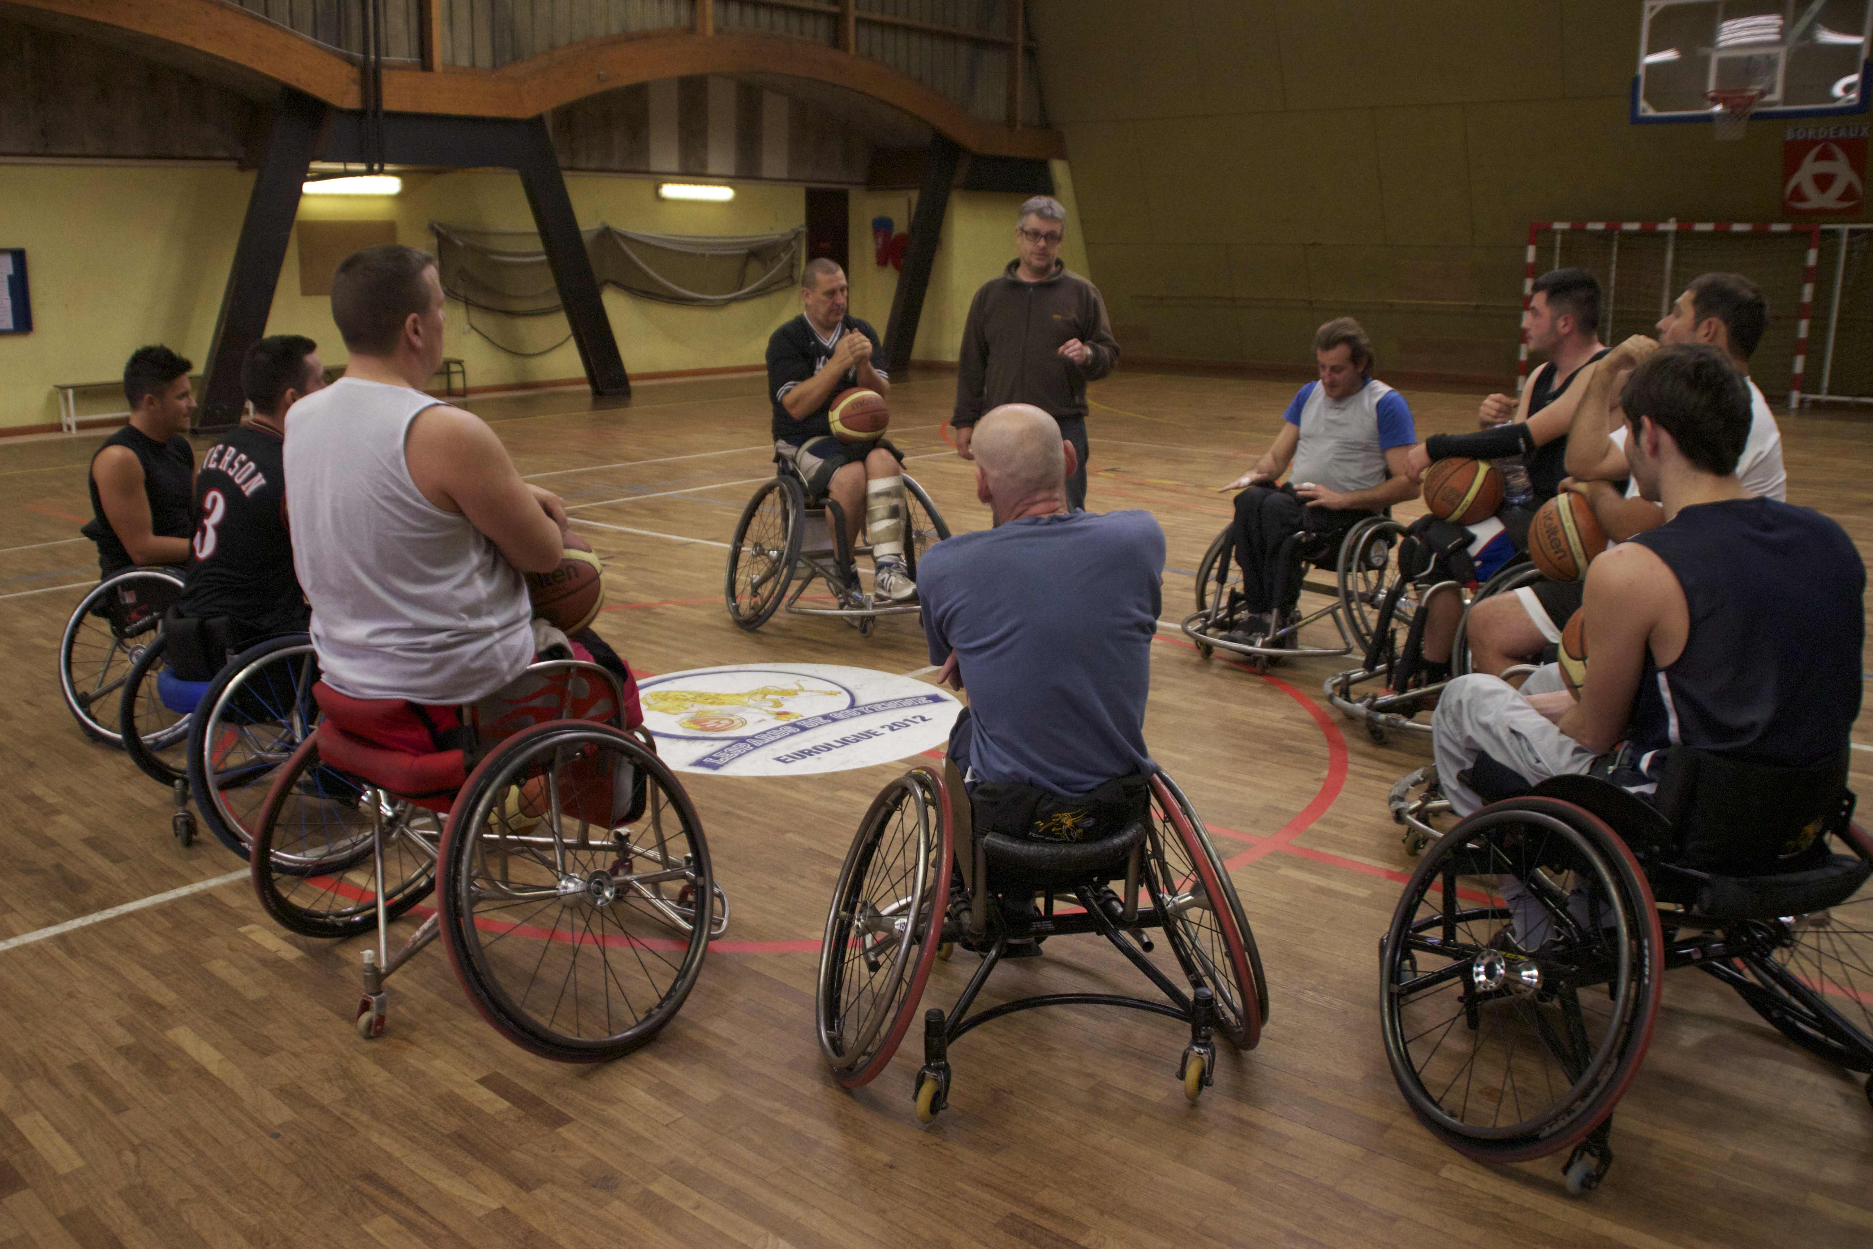
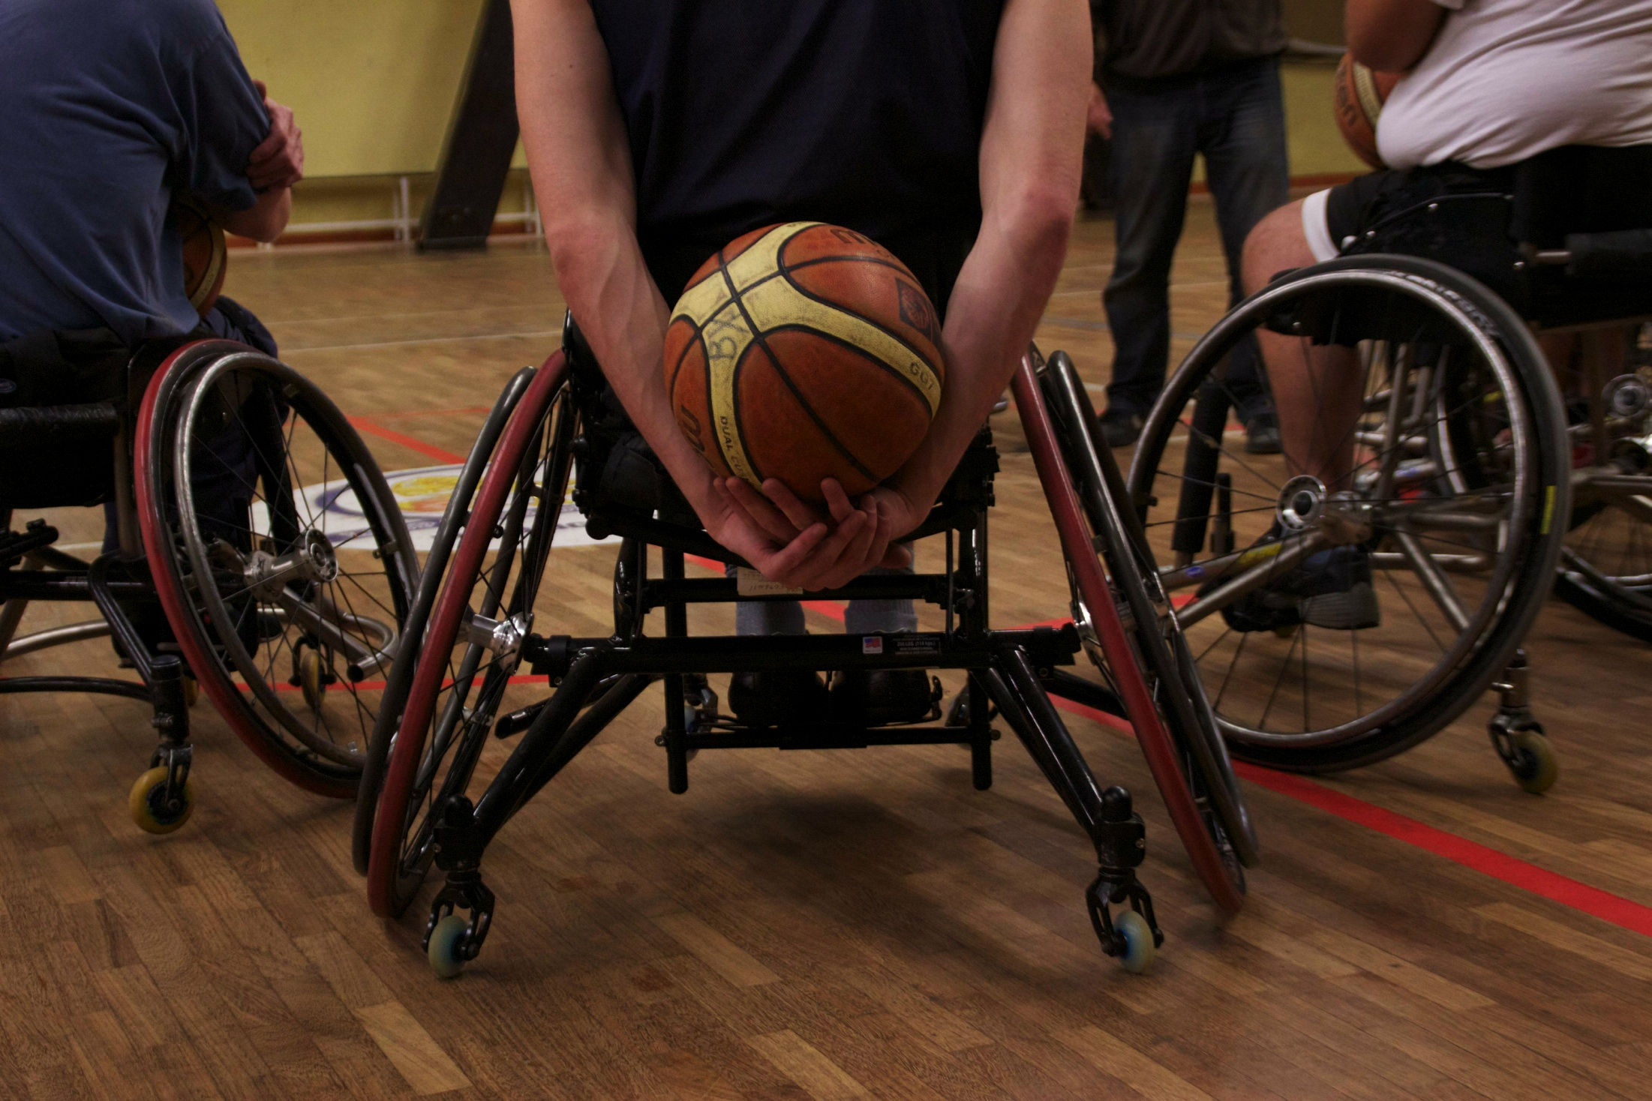
« Selon son handicap, chaque athlète vaut un certain nombre de points allant de un à cinq. Ces points sont calculés en fonction du degré de handicap. »
« Un athlète valide compte pour 5 points, tandis qu'un paraplégique vaut 1 point.
La somme des cinq joueurs de l'équipe sur le terrain ne doit pas excéder les 14 points. »

Slide 8
No wannabe female Zidanes at Girondins of Bordeaux
Pas de Zidanes au féminin aux Girondins de Bordeaux
Eduardo DEL CAMPO El Mundo - Spain Shirihuru EVANS Near FM - Ireland

Slide 9
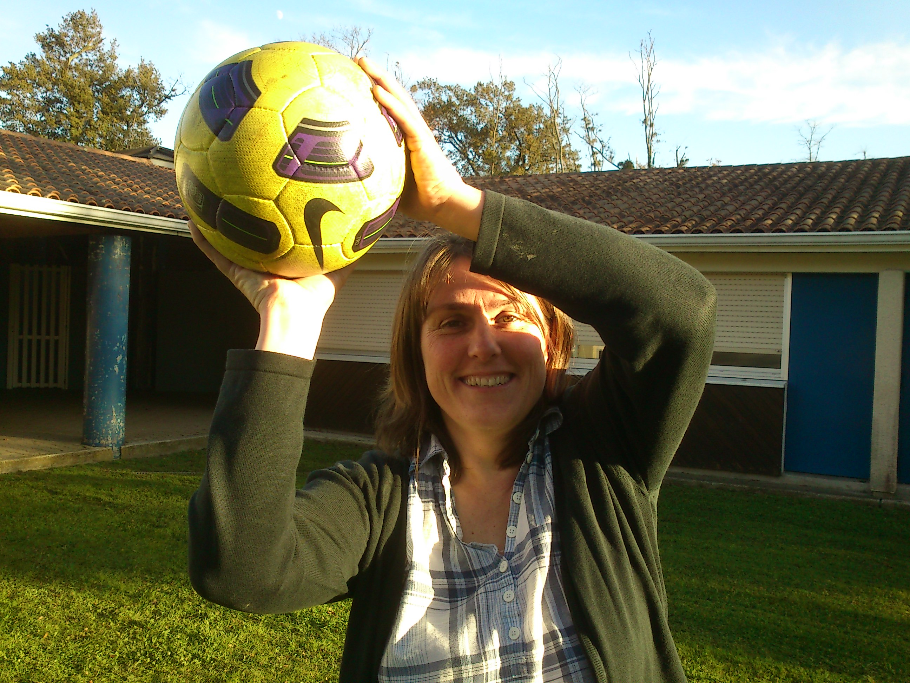
“If Girondins, where ‘Zizou’ rose to fame, becomes the last ‘male-only’ football club in France, they will look ridiculous” Sylvie Rousseau, in charge of women soccer development for the Aquitaine region

Slide 10
Hidden racism in Bordeaux
Bordeaux : le racisme caché
Rossitza STOYKOVA
7 Days Sport Newspaper - Bulgaria Celen OBEN
Star Media Group - Cyprus

Slide 11
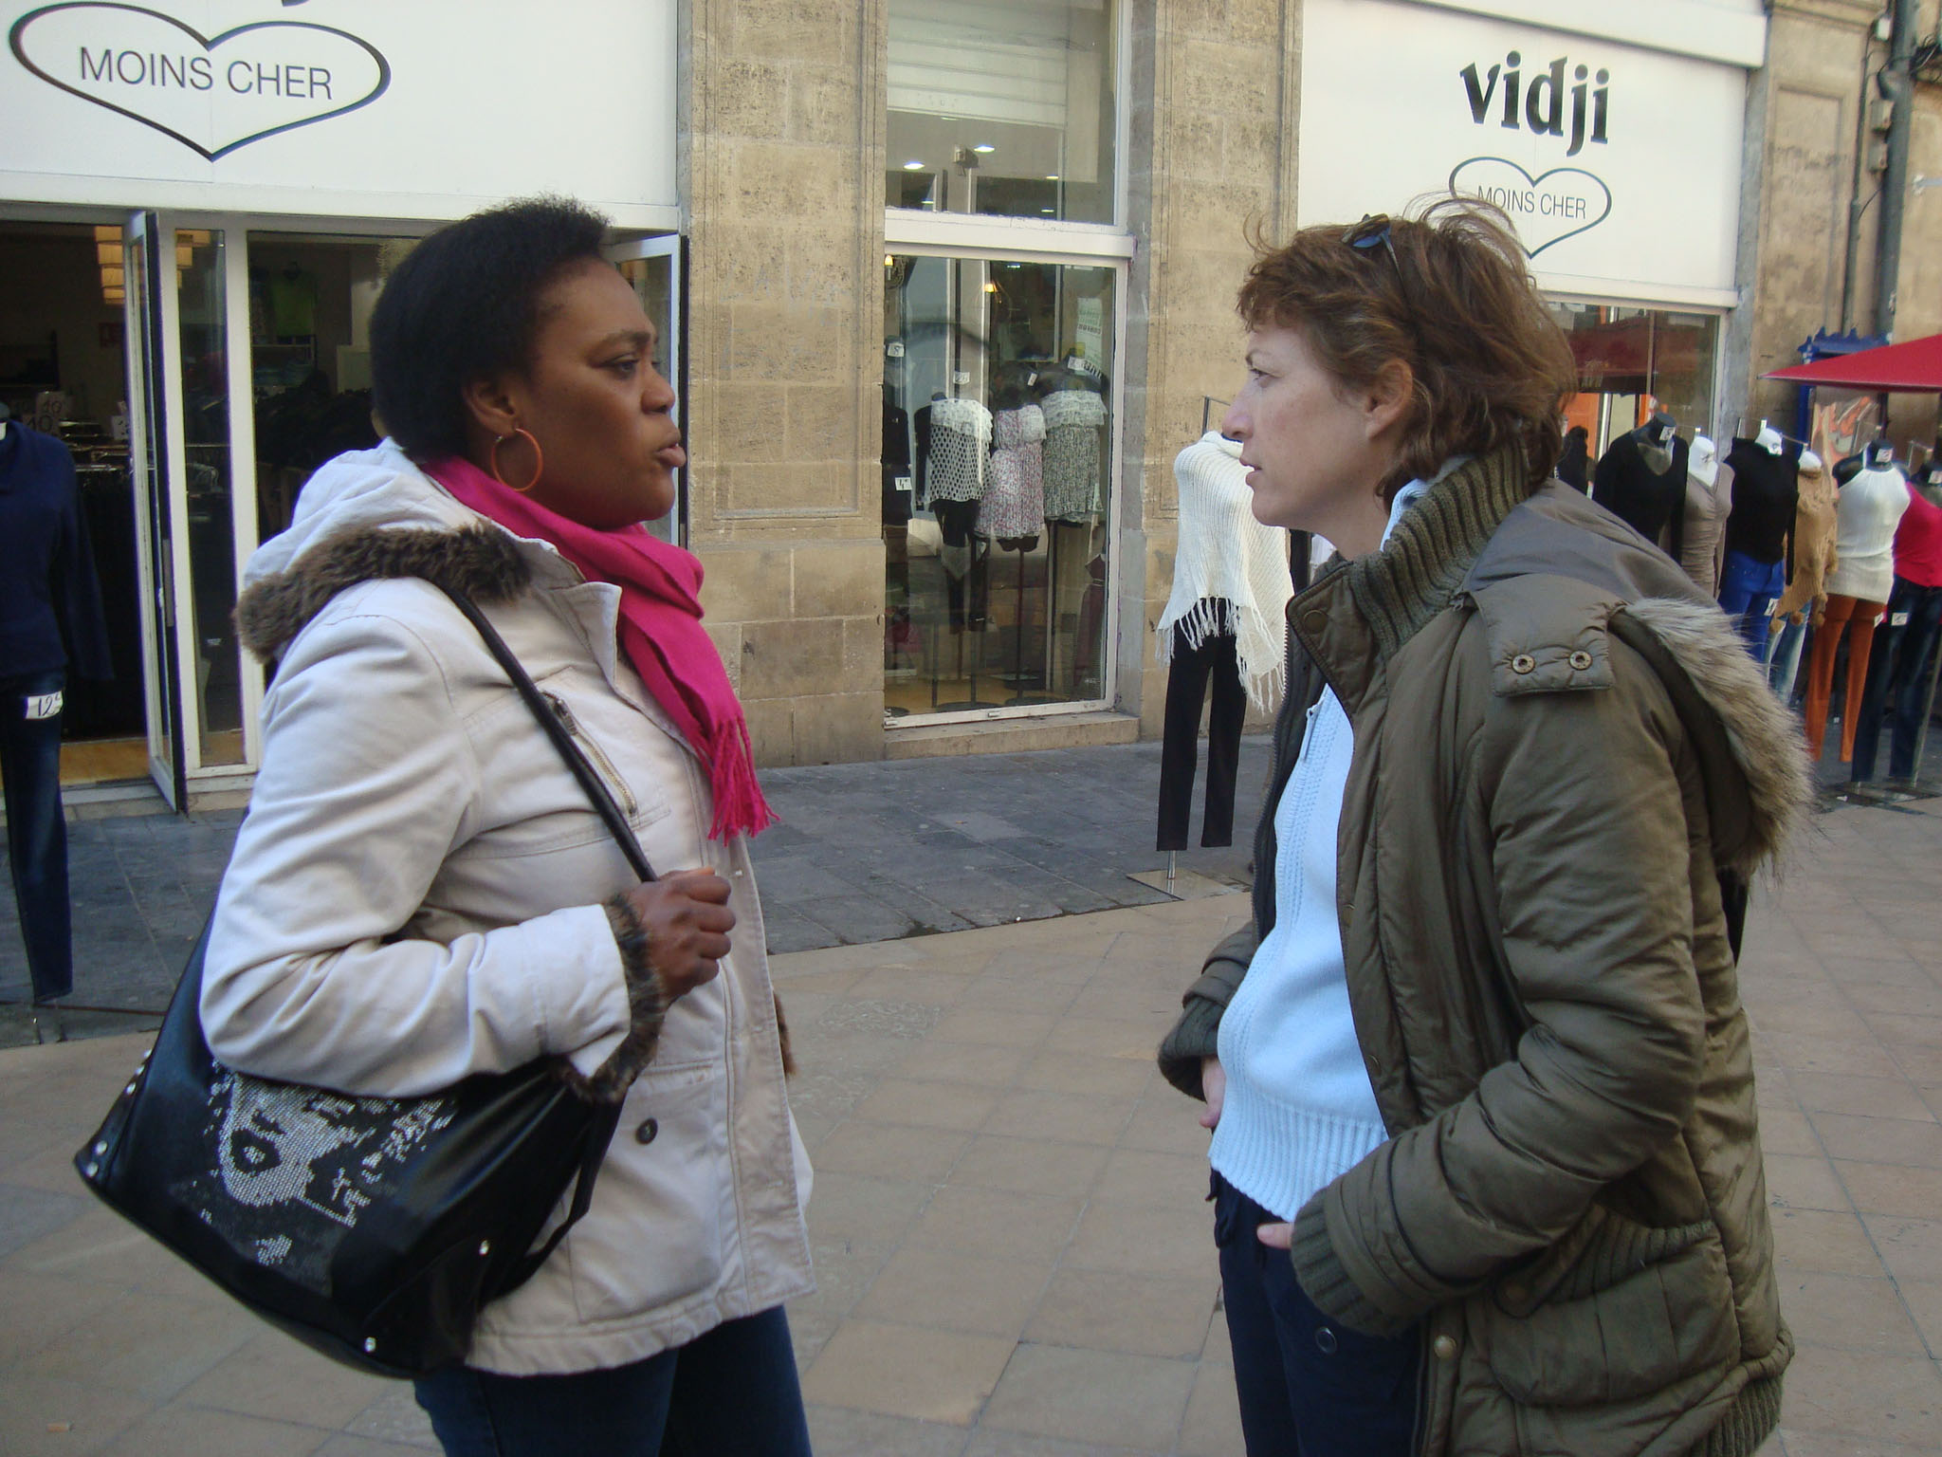
“There is a hidden racism in Bordeaux. People don’t admit it but it is a fact. People are talking about ‘the blacks’ and how bad they are. When you try to find a job some would prefer the white candidate, no matter the education or expertise.” Sylla Khabin, 23 years old

Slide 12
Vous pouvez retrouver ces articles sur www.coe.int/mars

Slide 13
Revue de presse ...

Slide 14
Is photojournalism a way to fight racism in sports?
Le photojournalisme : un moyen de lutter contre le racisme dans le sport ?
Nora SARGA Magyar Liget – Hungary
Jean-Paul VITRY Action Cinema Media Jeune - Belgium

Slide 15
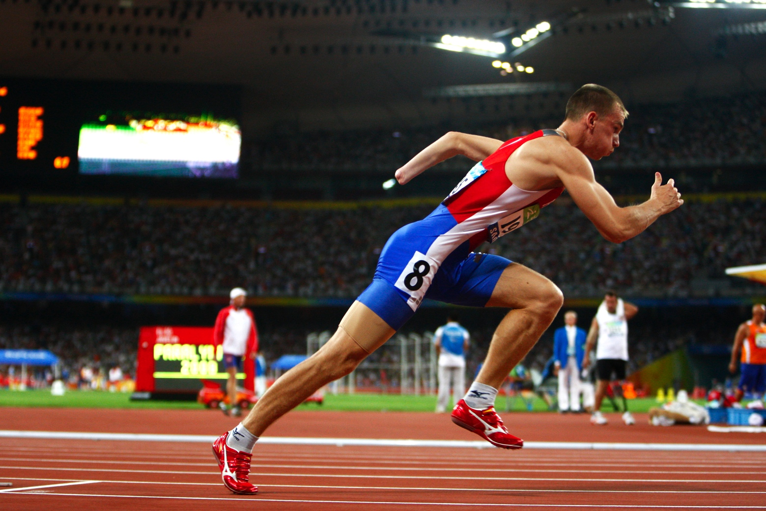
“My work is to talk about the sport but much more about the person but not talk about disability.” Mélanie Challe has been a freelance sports photographer for 5 years

Slide 16
Shared goals across borders: European unions working for ethical, inclusive and diverse
journalism
Svetla STOYKOVA Union of Bulgarian Journalists - Bulgaria
Mike Smith National Union of Journalists – Wales

Slide 17
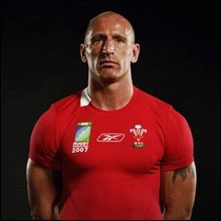
There remains a very strong tradition of open sexism in European media, and more or less homophobic attitude, perhaps reflecting a lack a reflection on these issues
Former Wales rugby international Gareth Thomas came out in 1995

Slide 18
Foot 33: She likes it and she shows it on the Web
Foot 33 : Elle aime le foot et elle l’affiche sur la toile
Paul-Michaël Borgne
L’Echo des collines - France
Bruno Horta
Time Out Lisboa - Portugal

Slide 19
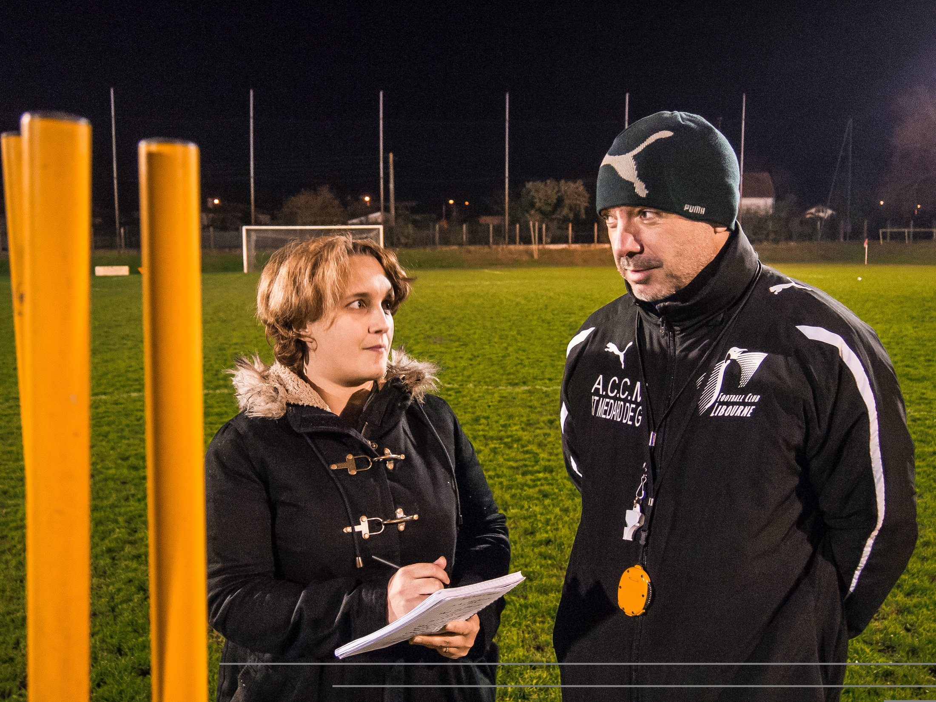
“They felt that amateur sport was lacking visibility in the mainstream media. Now, official numbers are about 3.000 daily pageviews. .”
Marie-Laure Julian talks to the trainer Bruno Brancher,
from Libourne football team

Slide 20
How to cover a local community’s agenda? The Echo des Collines example
Comment couvrir l’actualité locale : l’exemple de L’Echo des Collines
Pauline COMPAN
Saphir Media - France
Valentin TODOROV
Novi Iskar Online -Bulgaria

Slide 21
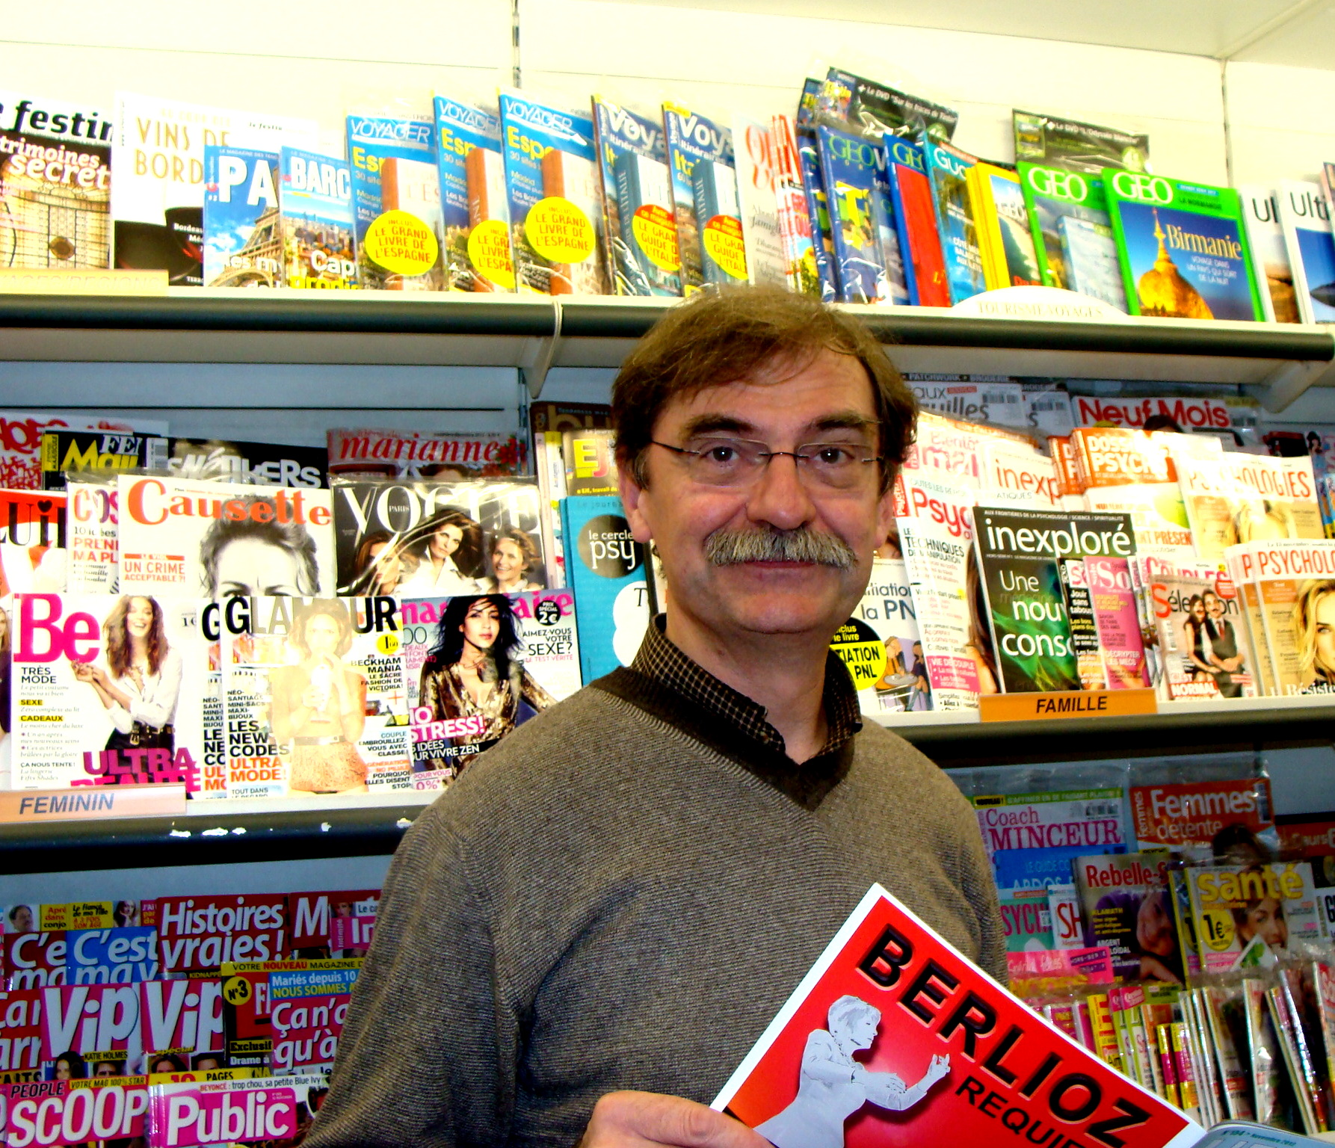
“This associative magazine tries to fill the gap in the information given by the biggest mainstream media in the region, with more or less success.” Jean, newstand owner

Slide 22
Can women write about sports?
Les femmes peuvent-elles écrire sur le sport ?
Ilze VAINOVSKA
Kursas Laiks – Latvia
Regina GOUVEIA Polytechnic Institute of Guarda - Portugal

Slide 23
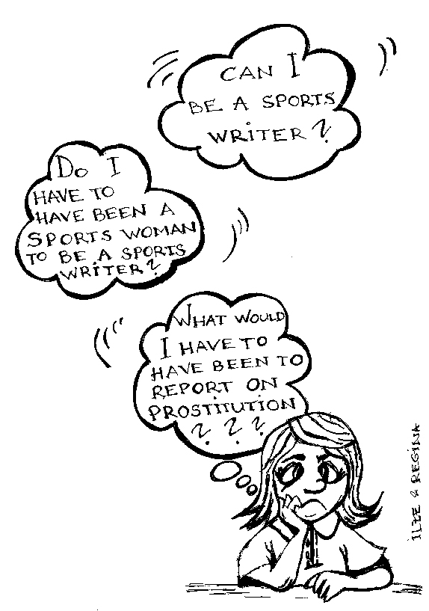

Slide 24
Chronique des Rencontres

Slide 25
Vous pouvez retrouver ces articles sur
www.coe.int/mars

